Slide 1
CommCare Data Flow Overview

Slide 2
CommCareHQ Reports

Slide 3
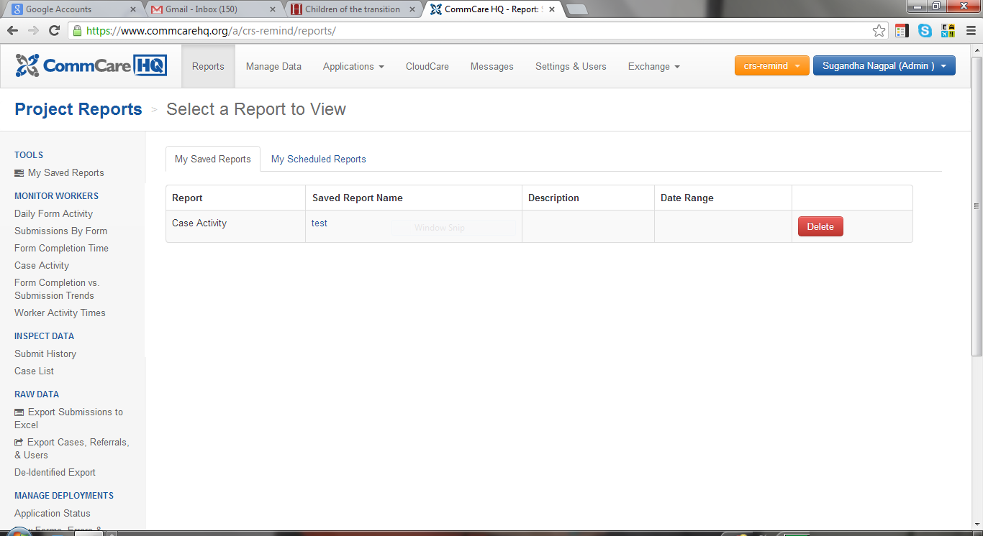
How to Access Performance Reports
Management, Tracking and Analysis of Worker Data
Support for Project Coordinators in managing workforce
Analyze all data submitted to server to improve worker performance
Targeted, actionable follow-up activities for supervisors
Weekly and monthly email reports
There are 6 Worker Monitoring Reports.
You may use the 2 Inspect Data Reports .

Slide 4
Worker Monitoring Reports

Slide 5
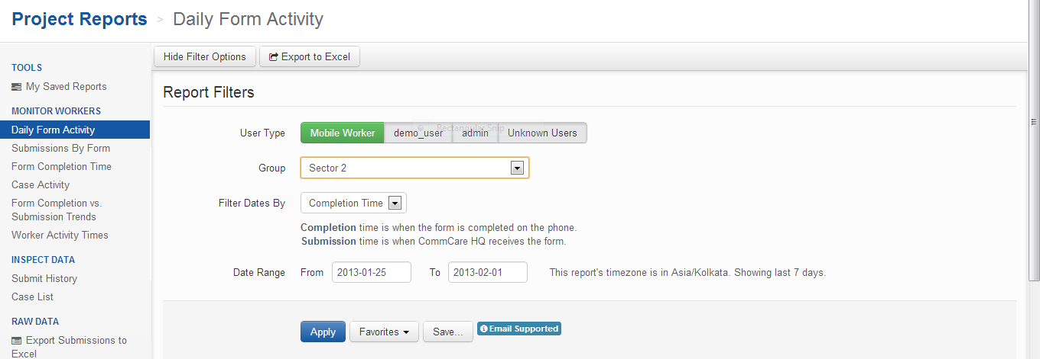
Filtering Reports
1. Sort by User Type
Mobile Worker
demo_user
admin
Unknown
2. Sort by Group
Sectors
PHCs
3. Sort by Date Range
4. Click on Apply
Notes:
Each report has some options for filtering the data. Here are some standard filter options for each report.

Slide 6
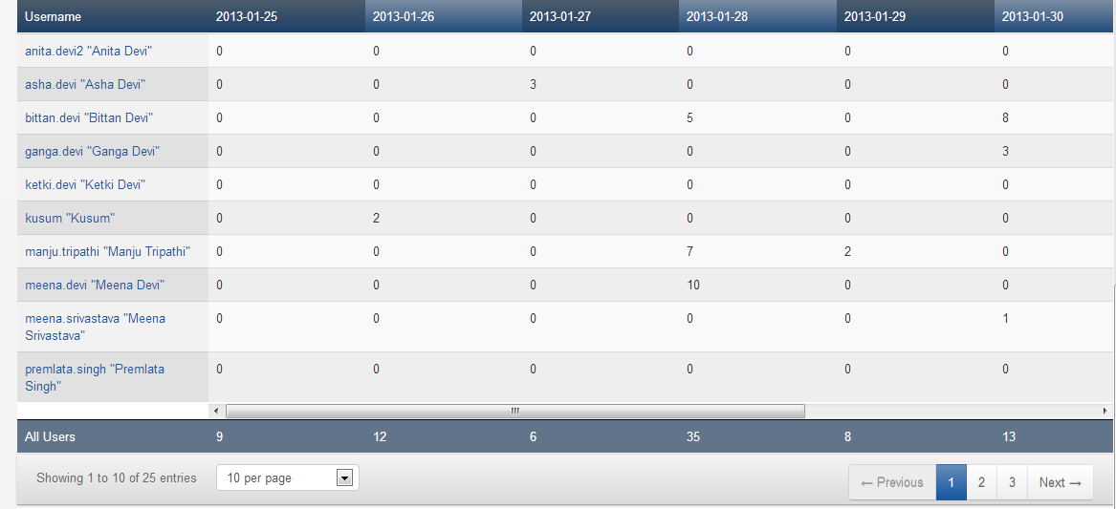
1- Daily Form Activity
(Number of Submissions per Day)
Which Sector is this report for?
What is the date range selected?
How many forms submitted on
Jan 27? By whom?
For more user data.
For more users per page.

Slide 7
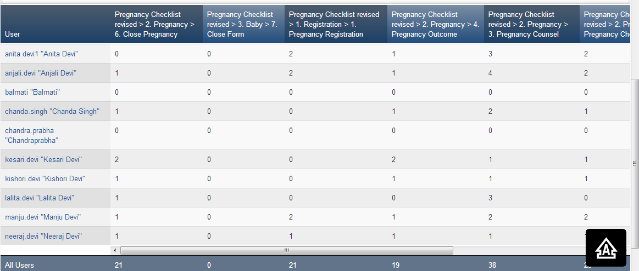
2- Submissions by Form
(Number of submissions by form)
How many total Pregnancy Registration Forms were submitted?
How submitted the most Pregnancy Counseling forms?

Slide 8
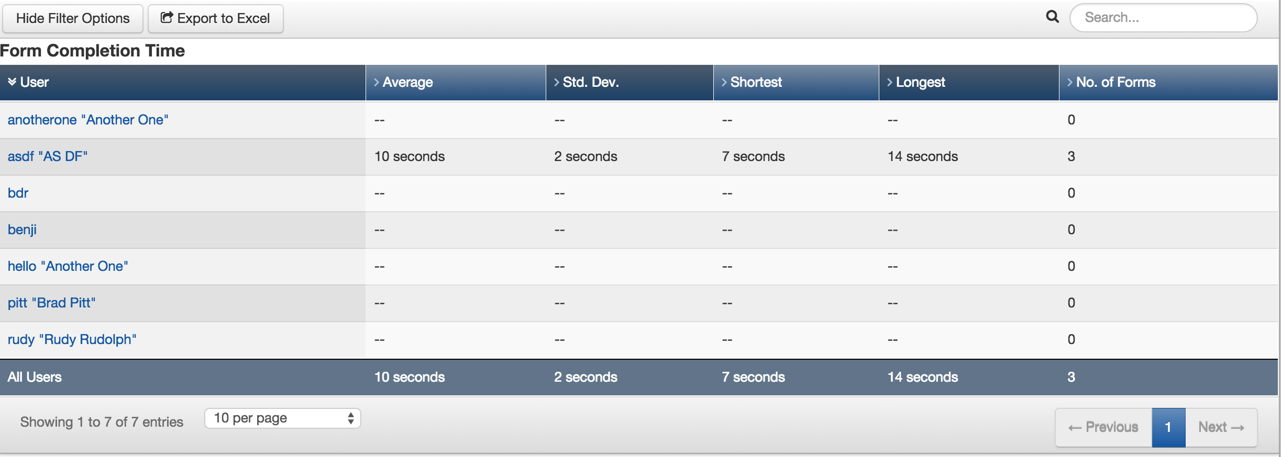
3 – Form Completion Time
What is AS DF’s average form completion time?

Slide 9
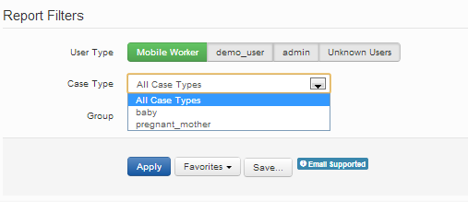
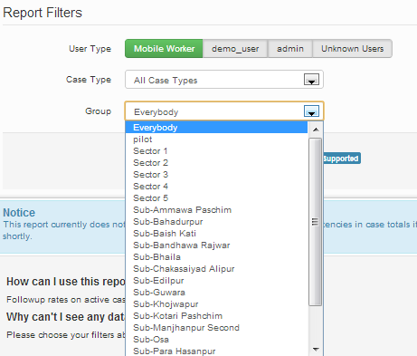
4 – Case Activity
(number and percentage of cases that have been modified over a given time period)
1. Select the case type
2. Select the group

Slide 10
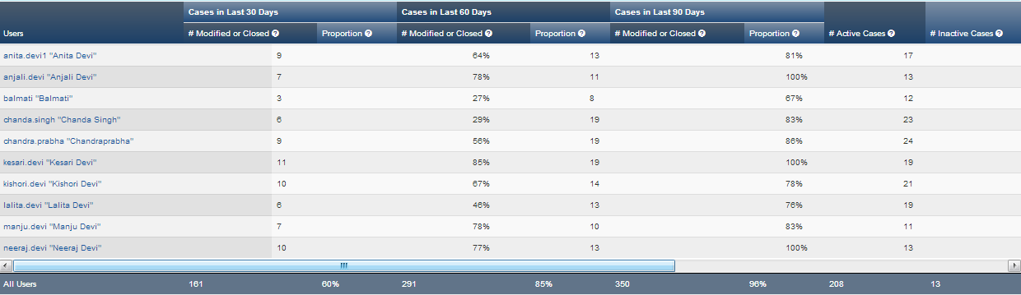
4 – Case Activity
(number and percentage of cases that have been modified over a given time period)
Activity in last 30 days
… 60 days
… 90 days
Updates to any form counts as a case modification, including opening and closing a case.
Click on the title to sort from high-> low

Slide 11
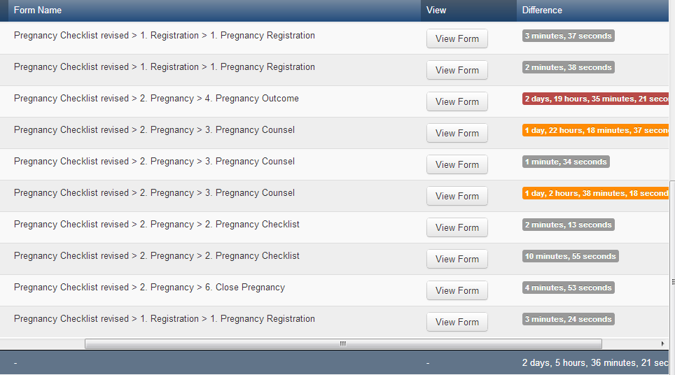
5 - Form Completion Vs Submission
(Captures time lag between when forms were completed
and submitted to Commcare HQ)
Form Completion – Time the form was completed in the mobile phone.
Form Submission – Time the form was successfully received by the server (CommCareHQ)
How can see you who is submitted these forms?
What can you say about a long lag time?
Average Lag Time

Slide 12
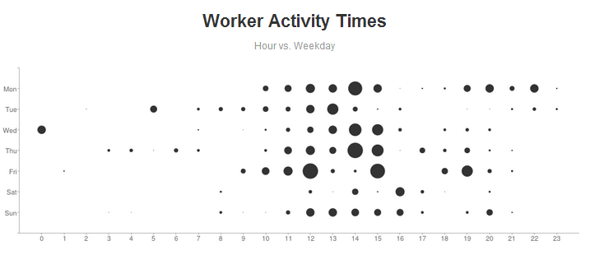
6 – Worker Activity Times
(Graphical representation of when forms are submitted and/or completed)
Which day of the week are most forms submitted?
What time of day are most forms submitted?

Slide 13
Inspect Data Reports

Slide 14
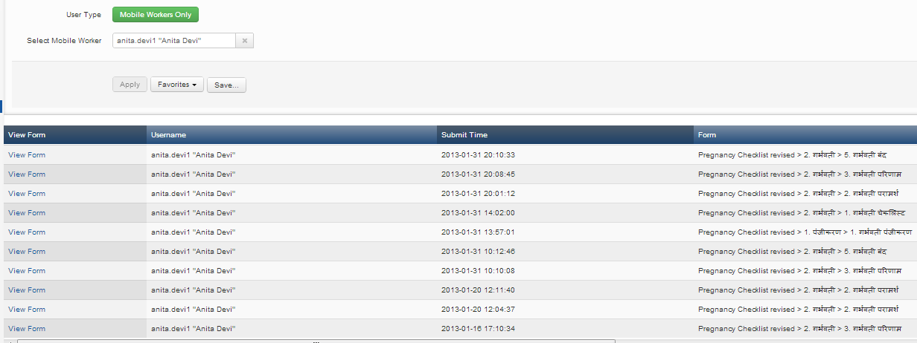
1 – Submit History
(Submission histories per user)
Select your user
When did this user last submit a form?
Which form was last submitted?

Slide 15
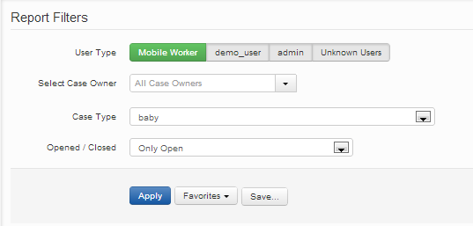
2 – Case List Filters
1. Select the user (if applicable). You might want to see all cases irrespective of case owner.
2. Select case type
3. Select closed or open cases
4. Click on Apply

Slide 16
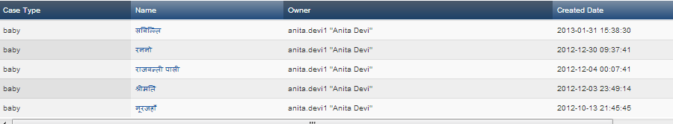
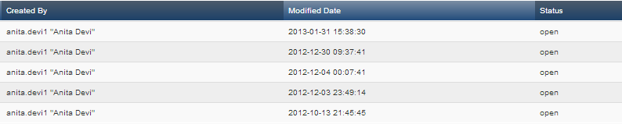
2 – Case List
Some applications have case sharing functionality.
Owner is the user who is updating the case in her list now.
Name of beneficiary
Date when case was registered
Name of user who originally created the case.
The last date the case was modified
Open/Closed Status
What does it mean if the created and modified date is the same?
Will a user be able to see a closed case in her mobile?

Slide 17
Reflection Questions for the Organization
How will you utilize performance data for field based supervision?
Can this data be integrated into your field monitoring processes?

Slide 18
Thank you!

